Slide 1
presentation to: name : md. Imran hossain assistant professor department of ict comilla university
presentation by:
Name :akther Hossen
Id:11809050
Department of ict
Comilla university

Slide 2
Simplify of monochrome television transmitter

Slide 3
Monochrome tv
Black and white tv : A television set that displays only monochrome images. A monochrome system of transmitting and receiving television signals.
Picture element : There are almost infinite elements in any picture ,so information of picture is very complex.

Slide 4
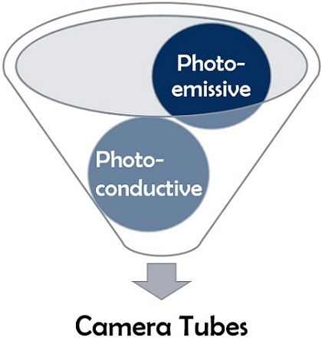
Components of monochrome tv transmitter
Camera Tubes : The video sequence at the transmitting station begins with a transducer which converts light into (video) electric signals.

Slide 5
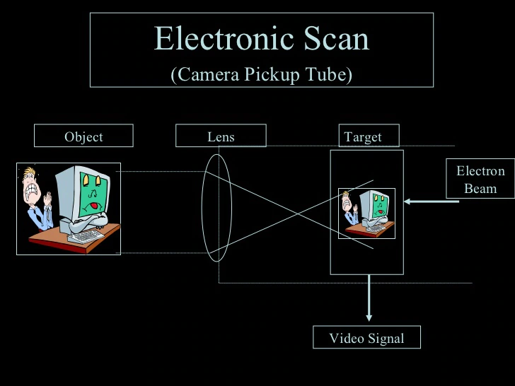
Components of monochrome tv transmitter
Video Stages : The output of the camera is fed to a video switcher which may also receive videotape or outside broadcast video signals at other inputs. The function of this switching system is to provide the many video controls required.

Slide 6
Components of monochrome tv transmitter
RF and sound circuitry
the sound transmitter is a frequency modulated transmitter the only difference is that maximum deviation is limited to 25KHz instead of the 75KHz limit for FM broadcast transmitter.
The RF aspects of the video transmitter must be broadband ,in view of the large bandwidth of the transmitted video modulated signals.

Slide 7
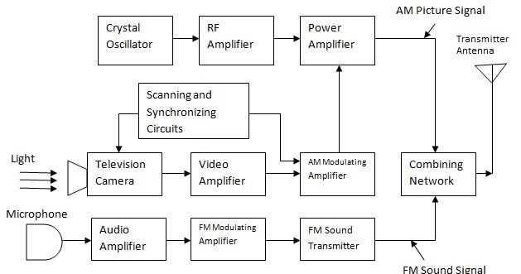
Block diagram of monochrome tv transmitter

Slide 8
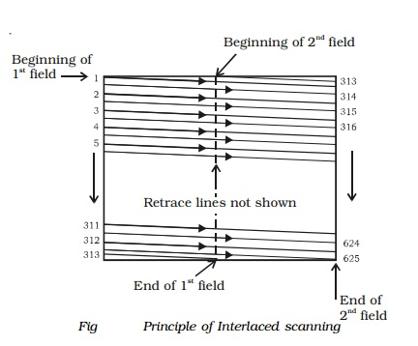
Working of monochrome tv transmitter
Scanning and synchronizing : A still picture is fundamentally an arrangement of many dark and light areas. Each small area of light or shade is called a picture element. All the elements contain the visual information in the scene. If they are transmitted and reproduced in the same degree of light or shade as original and in proper position, the picture will be reproduced

Slide 9
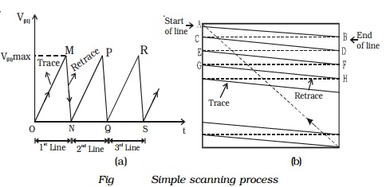
working of monochrome tv transmitter
Interlaced scanning : In India, the frame repetition rate has been standardised at 25 frames per second. This repetition rate is enough to cause an illusion of continuity. But, the brightness of one frame blends (mix) smoothly into the next, through this time when the screen is blanked between successive frames.

Slide 10
Parameter of monochrome tv transmitter
It transmits on channels in VHF and UHF.
RF carrier
Antenna size : Picture when the pass of signal that’s ar reduce antenna size.
It has a video information ,in between black and white with the shades of gray.

Slide 11
Thank You

